Slide 1
Electronics & Electricity
Unit 3 – Ohms Law
Section 1 – Ohms Law

Slide 2
Ohms Law
Ohms Law

Slide 3
Google classroom code
1c62ger

Slide 4
QUIZ REVIEW
Average grade was a 138.33 out of 150
92.2 %
Great job class!
Grades ranged from 90 – 150 points
Only 18 responses of 22
Be sure to not miss anymore quizzes moving forward

Slide 5
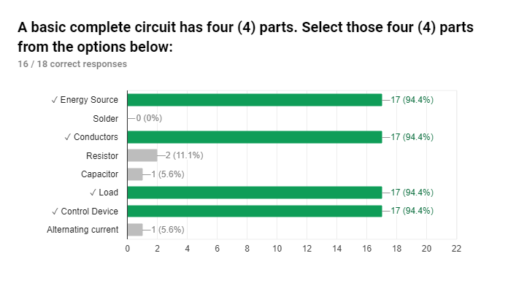

Slide 6
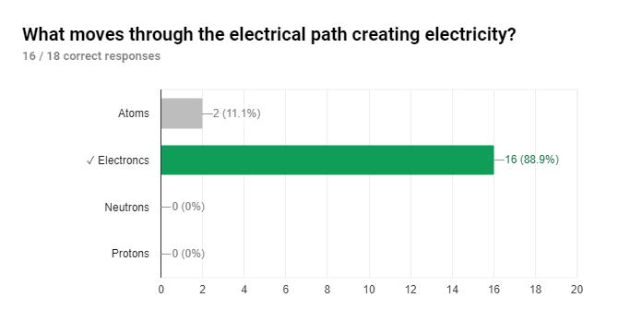

Slide 7
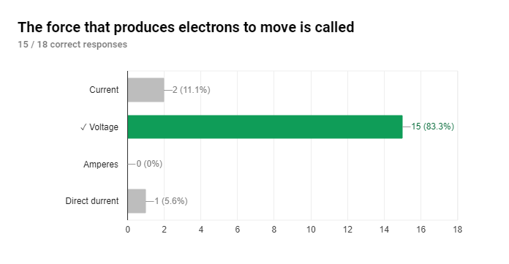

Slide 8
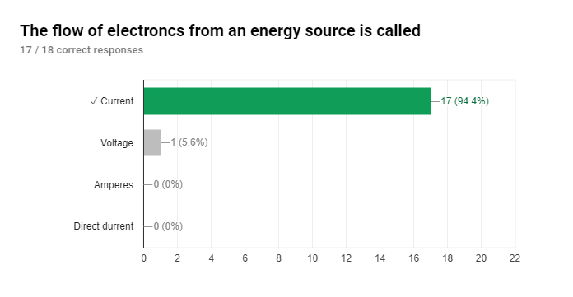

Slide 9
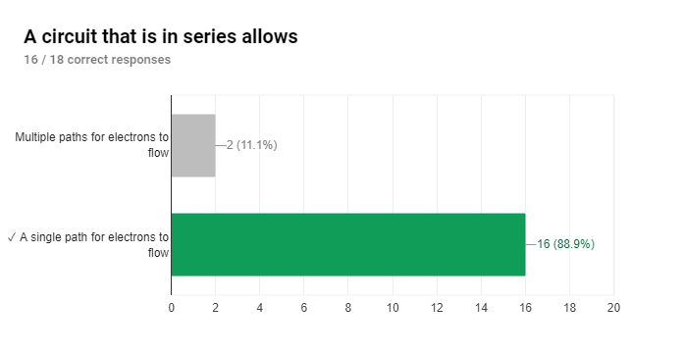

Slide 10
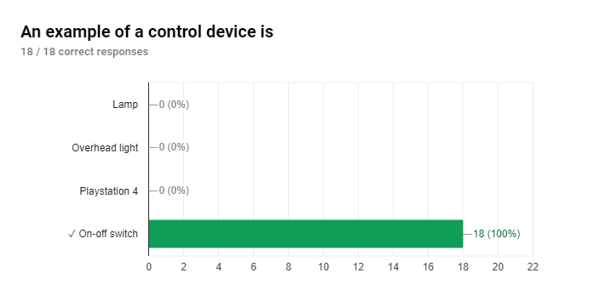

Slide 11
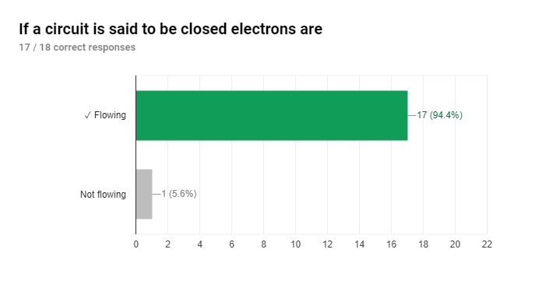

Slide 12
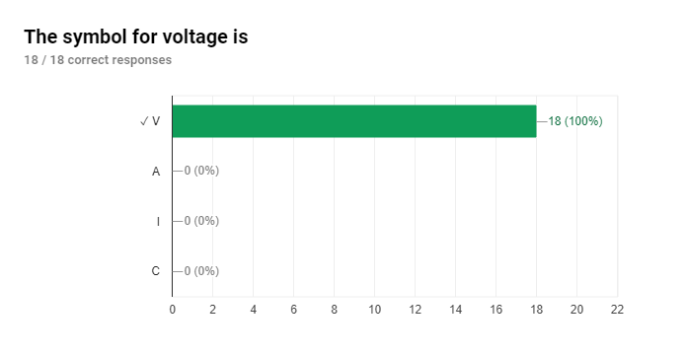

Slide 13
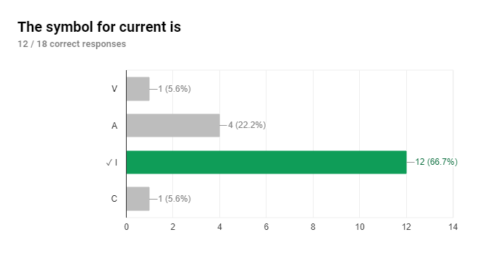

Slide 14
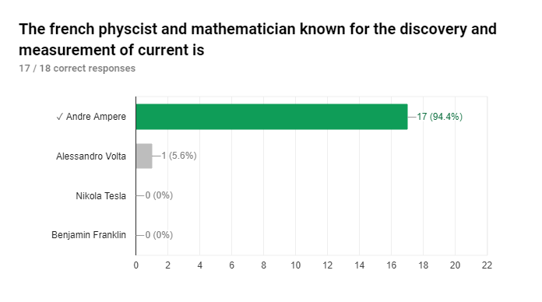

Slide 15
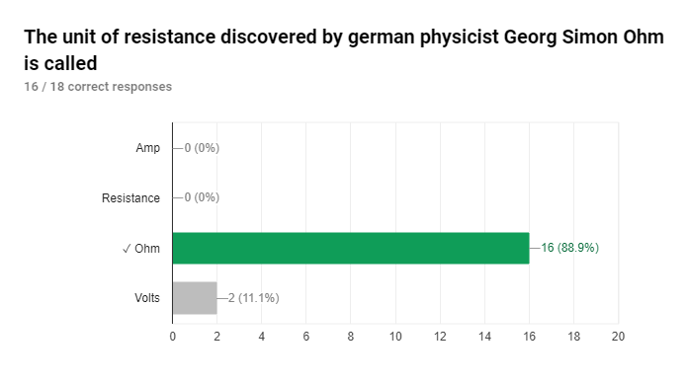

Slide 16
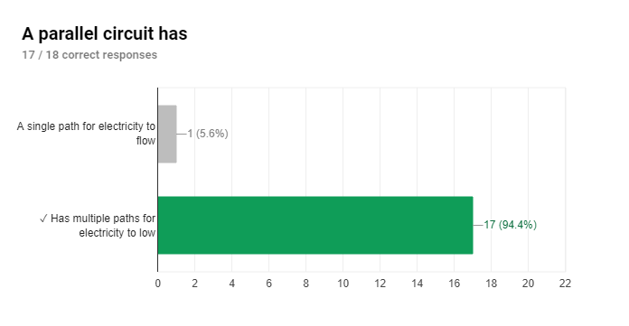

Slide 17
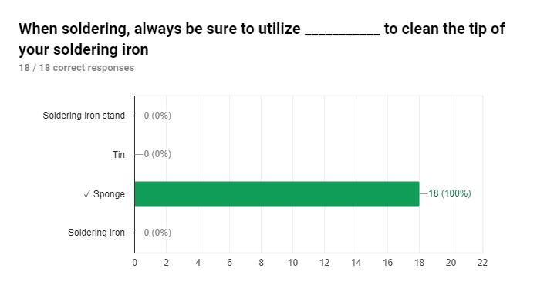

Slide 18
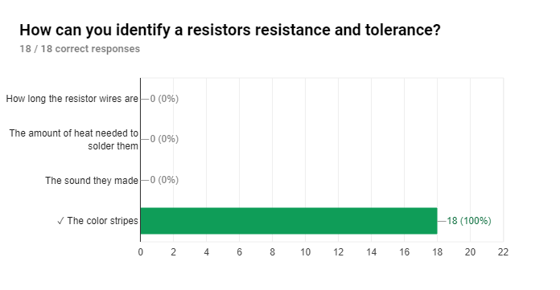

Slide 19
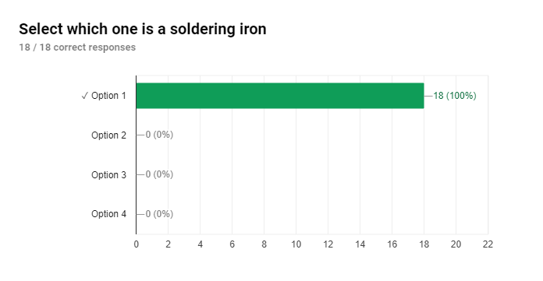

Slide 20
The big idea
Use the letter symbols for voltage, current, and resistance to show the relationship between them
Calculate the current, voltage, and resistance in a circuit when any two are known quantities
Determine the wattage of an electric circuit when the current and voltage are known
Find the cost of operating an electrical product for a period of time if the cost per kilowatt-hour is known

Slide 21
Terms
Kilowatt-hour
Ohm’s law
Power
Power formula
Resistance
Watt
Watt-hour meter

Slide 22
Ohm’s Law
The opposition to the flow of electrons in a circuit is resistance
The law that presents the relationship between voltage, current, and resistance is known as Ohm’s Law
The discovery is credited to George Simon Ohm in 1827
The voltage needed to force a given amount of current is equal to the product of the current and resistance in the circuit
The amount of current in a circuit is equal to the voltage applied to the circuit divided by the resistance of the circuit
The resistance of a circuit is equal to the voltage applied divided by the amount of current

Slide 23
Ohm’s Law Formulas
Letter symbols
Voltage (E or V)
Current (I)
Resistance (R)
To solve for E (voltage), use the formula:
E = I x R
To solve for I (current), this same formula can be written as:
I = E / R
To solve for R (resistance), arrange it as
R = E / I

Slide 24
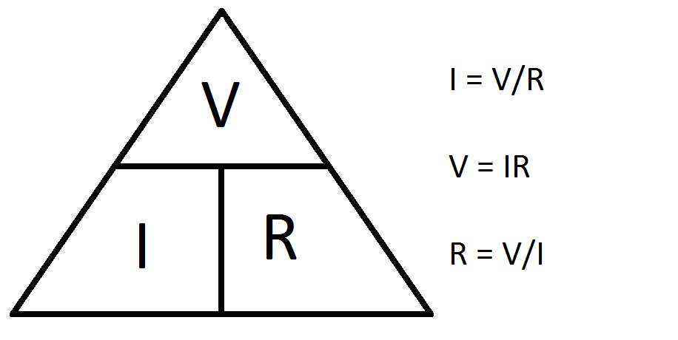

Slide 25
LP 2

Slide 26
Ohms Law
Letter symbols
Voltage (E or V)
Current (I)
Resistance (R)
To solve for E (voltage), use the formula:
E = I x R
To solve for I (current), this same formula can be written as:
I = E / R
To solve for R (resistance), arrange it as
R = E / I

Slide 28
Ohm’s Law Practice Worksheet

